Slide 1

SALES PERFORMANCE
LAYA MATHEW

Slide 2
SALES PERFORMANCE AND PROFIT BY:-
PRODUCT NAME
CATEGORY
REGION
MONTH

Slide 3
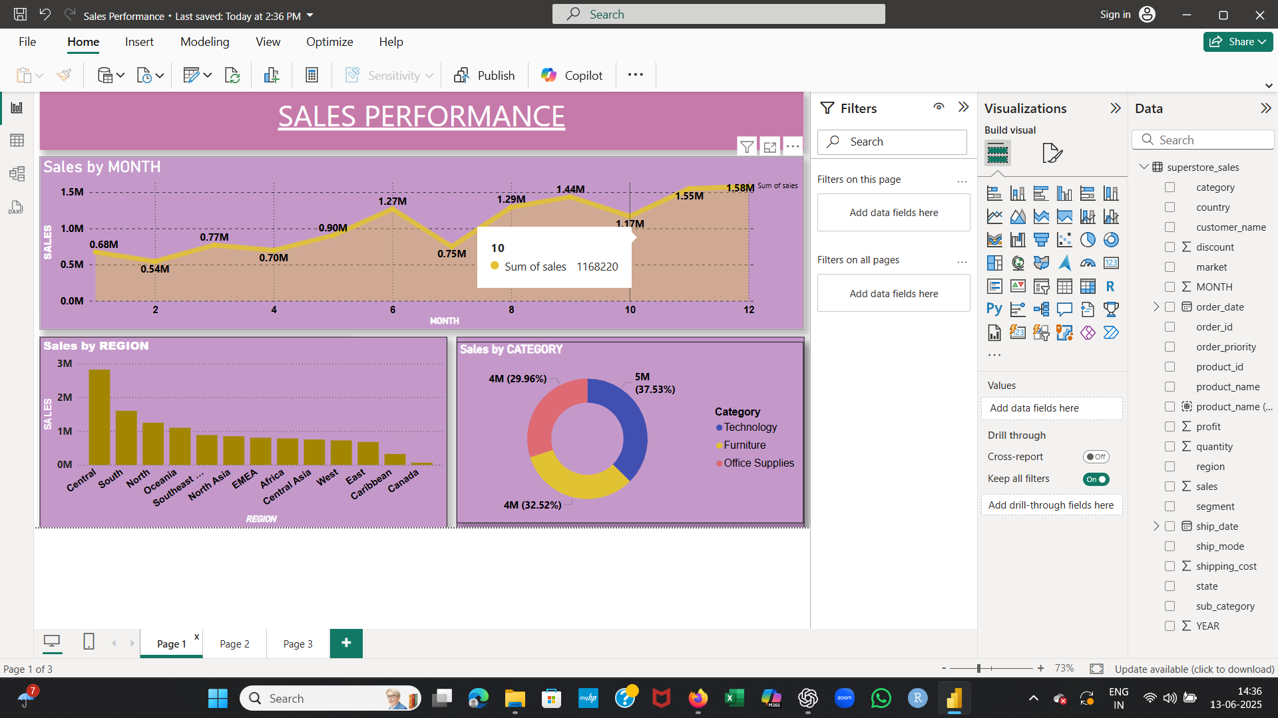
SCREENSHOTS

Slide 4
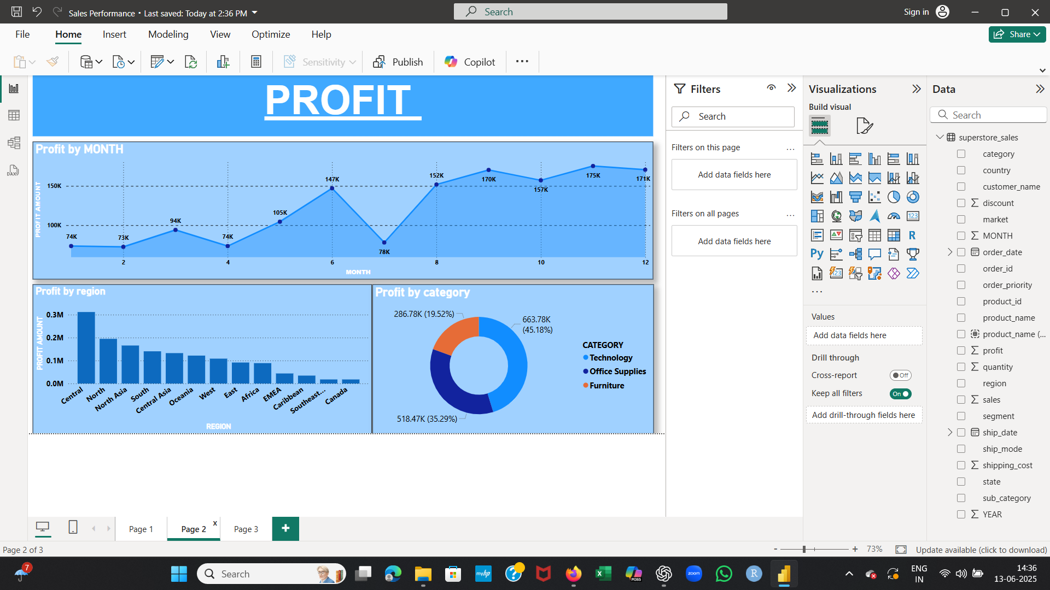

Slide 5
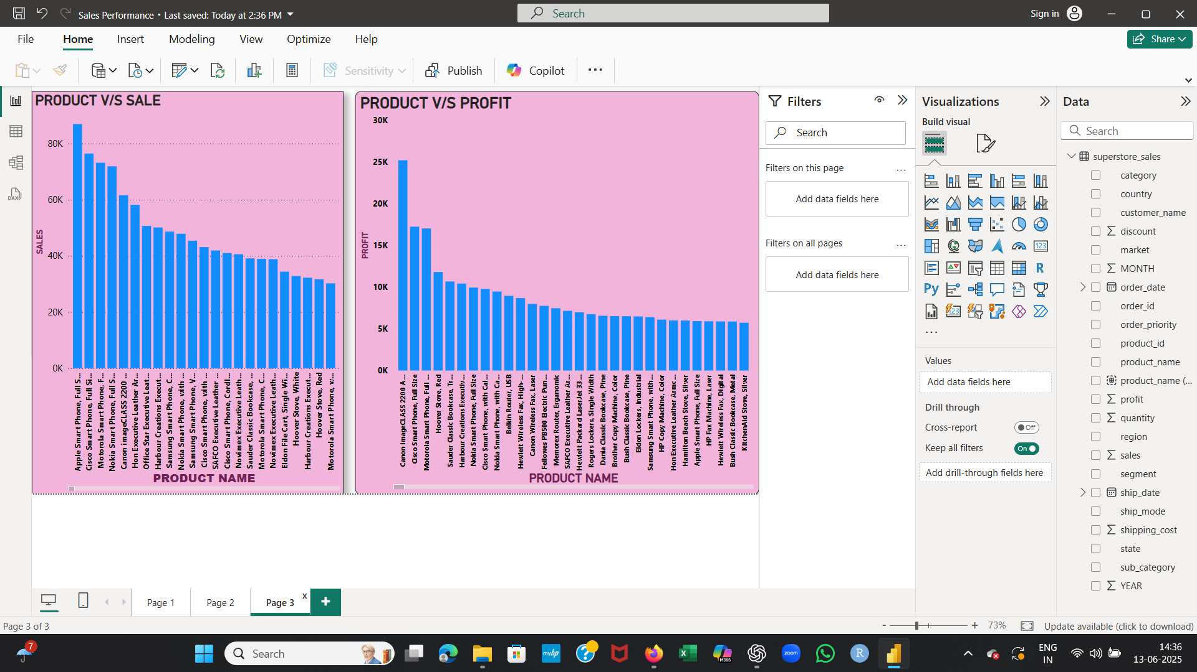

Slide 6
1.SALES PERFORMANCE IS IN PEAK AT THE TIME OF NOVEMBER AND DECEMBER (AT THE TIME OF YEAR ENDING). 2.SALES IS MOSTLY IN THE CENTRAL REGION. 3.PRODUCTS IN TECHNOLOGY CATEGORY IS SELLING MORE. 4.APPLE SMART PHONE IS THE HIGHLY SELLING PRODUCT. 5. PROFIT IS ALSO PROPORTIONATE TO SALES IN EACH ATTRIBUTE.
INSIGHTS FROM ANALYSIS

Slide 7
THANK YOU

